Slide 1
CAD HW3 Coverage Analysis
TA :Hua-Wei Huang
Lab :ED-413

Slide 2
Overview
Target
Use the tool to analyze your design and correct it
Given files:
cpu_bug.v – 8 bit CPU (has some bugs, but compilable)
Test.v – testbench file (has not completed)
HW3_Coverage Analysis.pptx
To do (Problem):
Generate 20 patterns randomly (test_random.v) to analyze coverage
Base on CPU operation, create some patterns to test the original cpu_bug.v with coverage analysis. Can you use less number of test patterns than random approach?
Find the bugs in the cpu_bug.v (if any) and correct them
Improve your test.v to increase the coverage rate to 100%
Do not generate patterns randomly

Slide 3
Verilog Compiler Simulator (VCS)
Verilog Compiler Simulator is a tool from Synopsys
This Tool is designed to simulate and debug designs
Operate Step:
Compiling the Verilog/VHDL source code
Running the simulation
Debugging and analyzing coverage
vcs
simv
Verdi

Slide 4
Code Coverage Definition
Verilog Code Compiling
source /usr/cad/synopsys/CIC/vcs.cshrc
vcs -full64 -cm line+tgl+fsm test.v cpu_bug.v
Line Coverage (line)
Check every assignment
Toggle Coverage (tgl)
Ensure transitioned 0 → 1 and 1 → 0
FSM Coverage (fsm)
Check states and state transitions

Slide 5
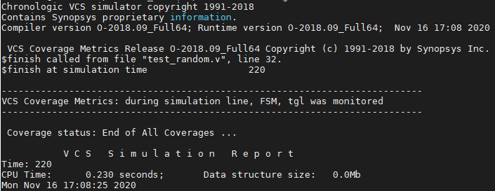
Verilog Code Simulation
./simv -cm line+tgl+fsm

Slide 6
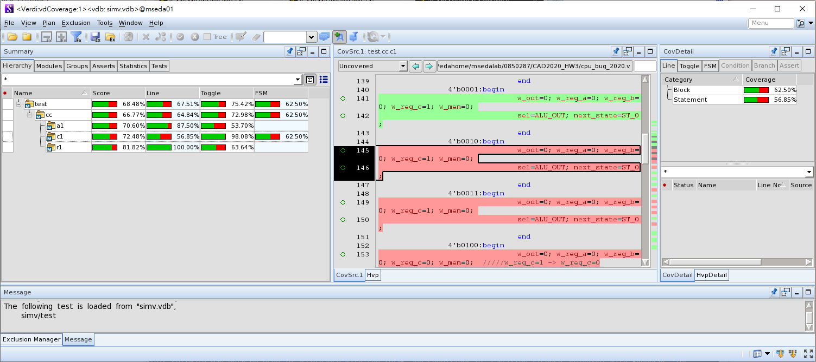
Verdi
source /usr/cad/synopsys/CIC/verdi.cshrc
verdi -cov -covdir simv.vdb &
Red : untested code are highlighted

Slide 7
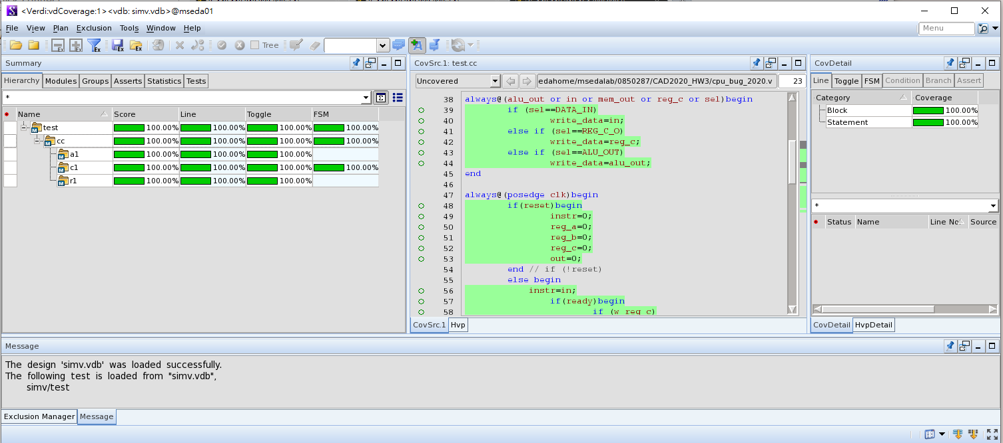
Simulation Result
Complete!

Slide 8
Verdi
nTrace
source code analyzer
display the design hierarchy and source code
Verilog, VHDL, SysmVerilog, SystemC, PSL, OVA, mixed
nWave
graphical waveform viewer
nSchema
generate interactive debug-specific logic diagram
showing the structure of selected portions of a design

Slide 9
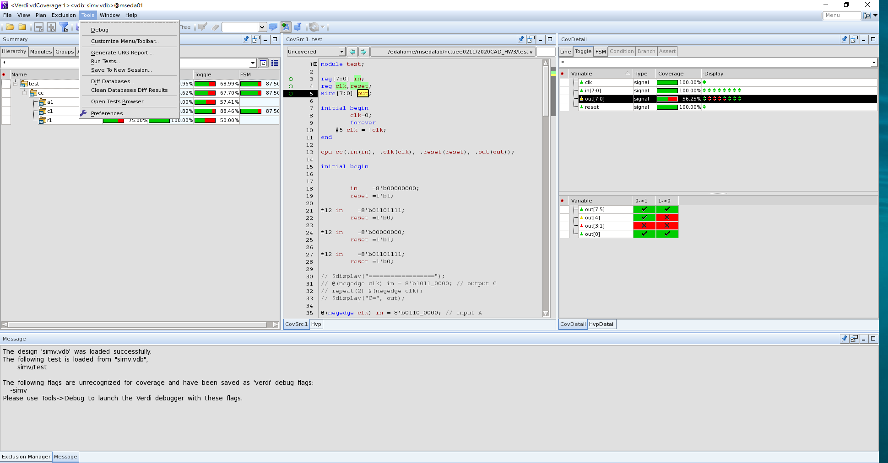
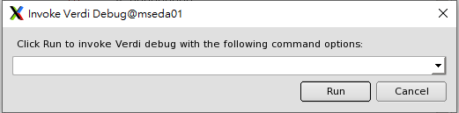
How to open nTrace
1
2
3

Slide 10
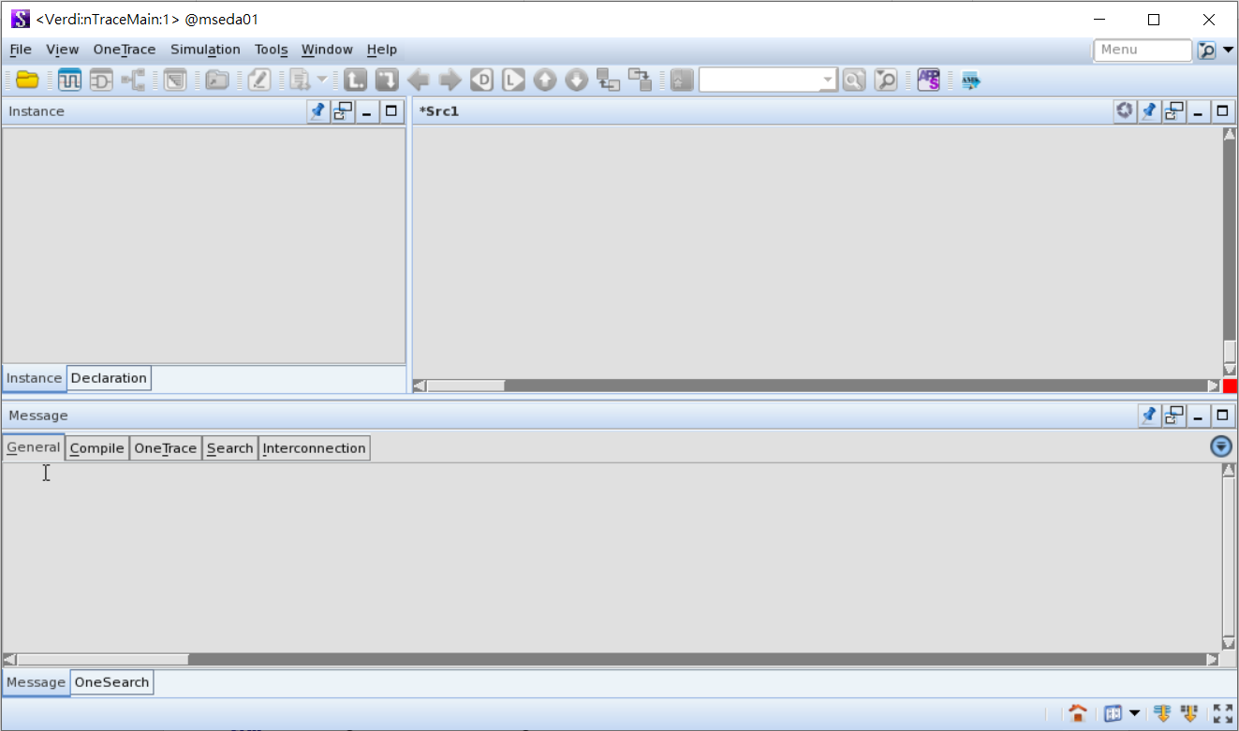
nTrace
verdi
Import Design

Slide 11
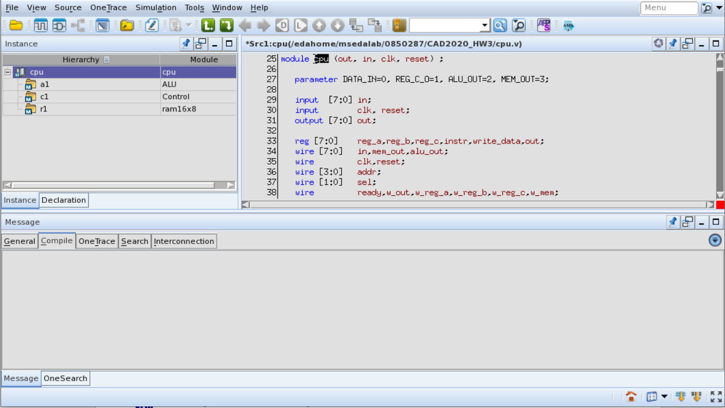
Hierarchical
Browser
Netlist Code
Window
Message
Window

Slide 12
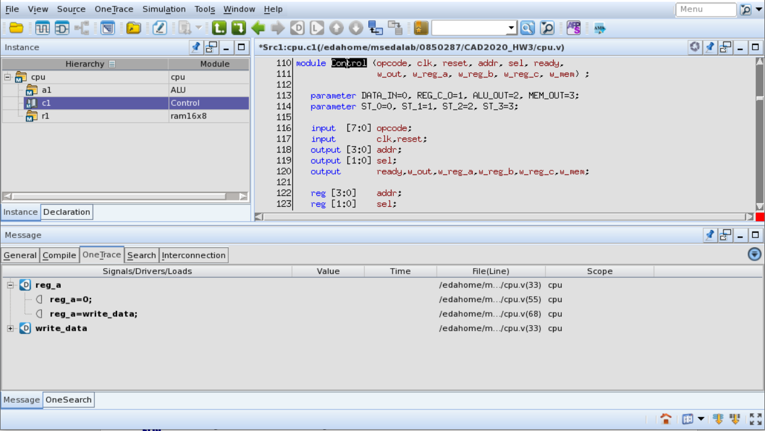
2 Calling
1

Slide 13
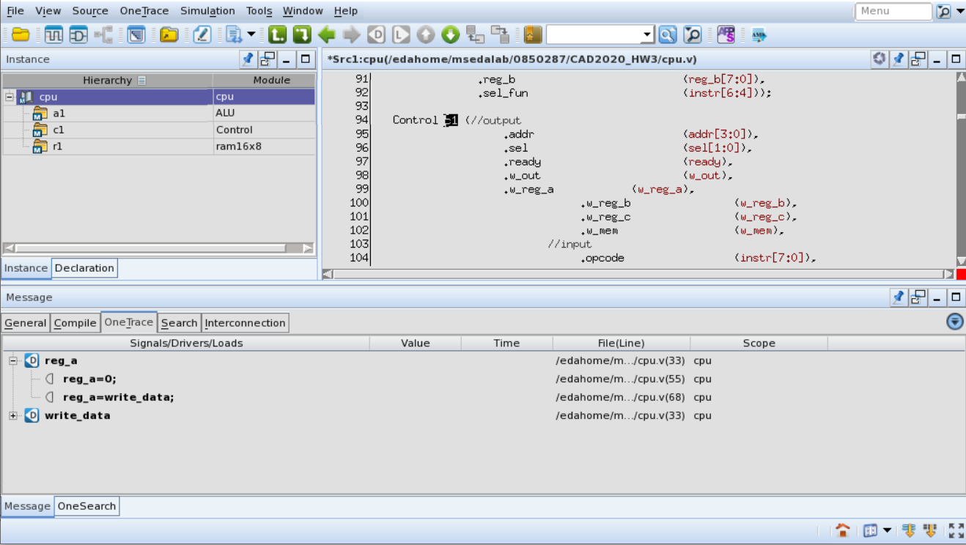
2 Definition
1

Slide 14
Backward History
Forward History

Slide 15
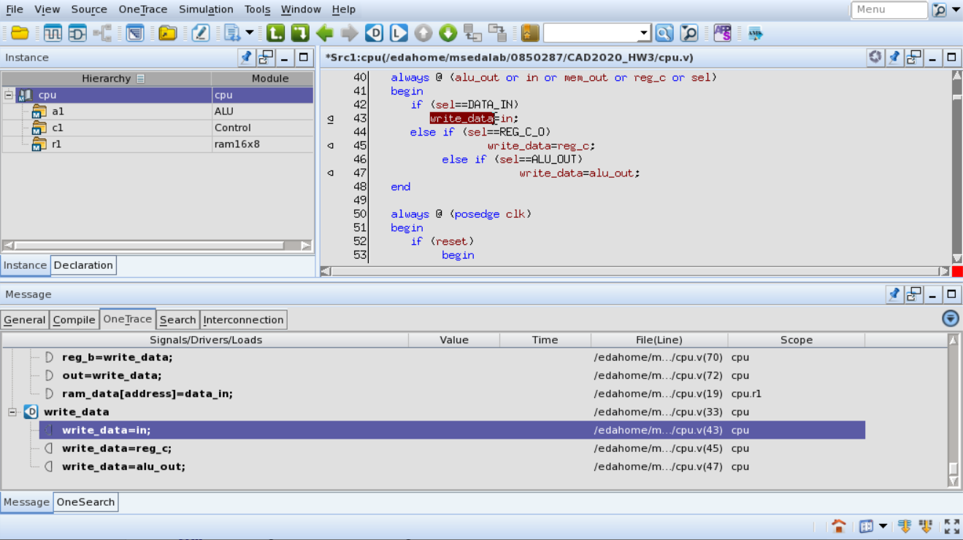
Driver
Show Previous/Next

Slide 16
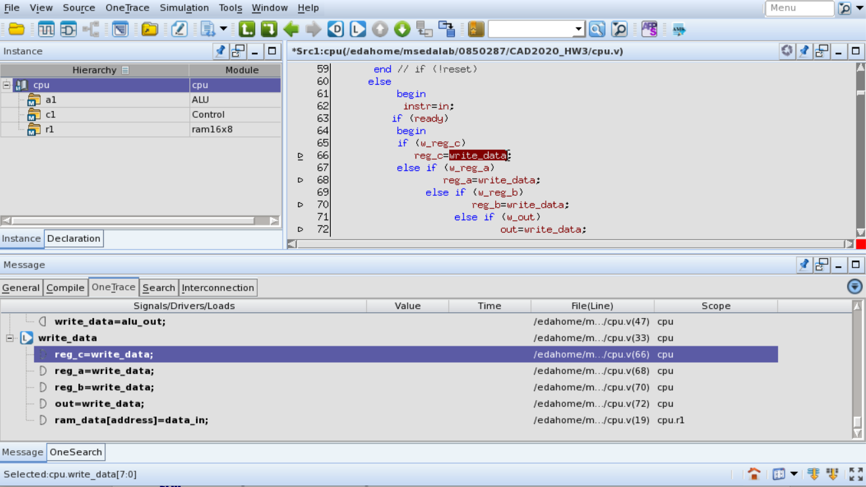
Load

Slide 17
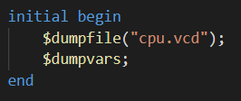
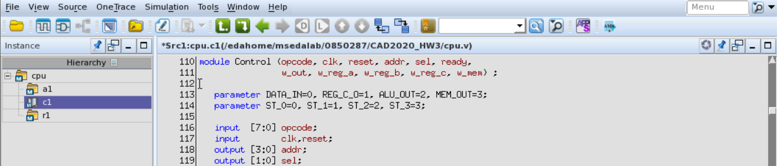
nWave
Test pattern
New Waveform

Slide 18
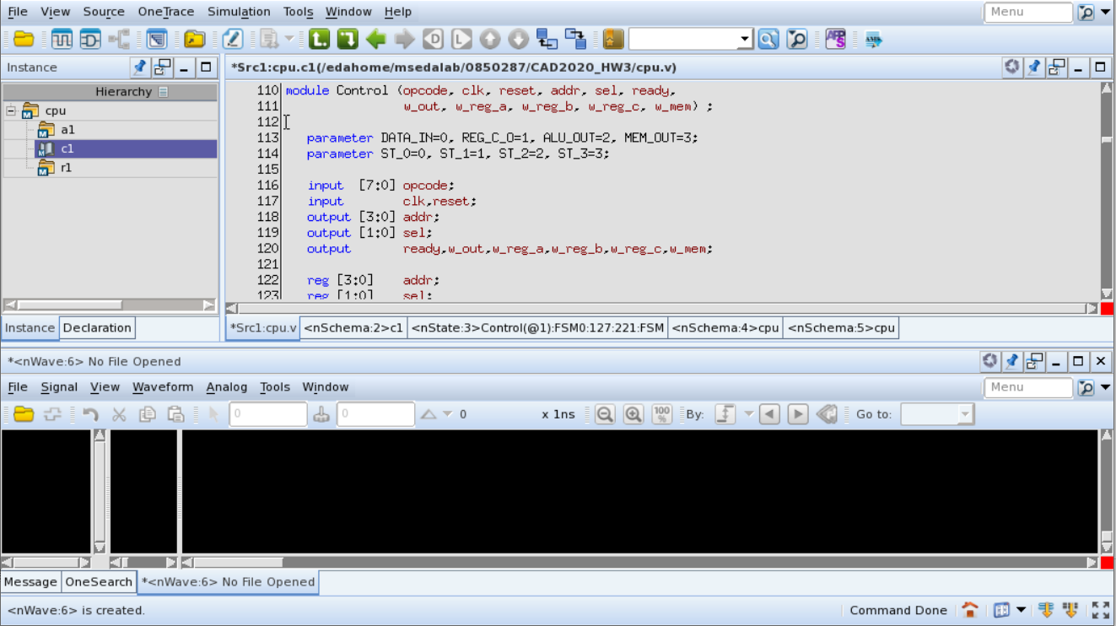
Open File

Slide 19
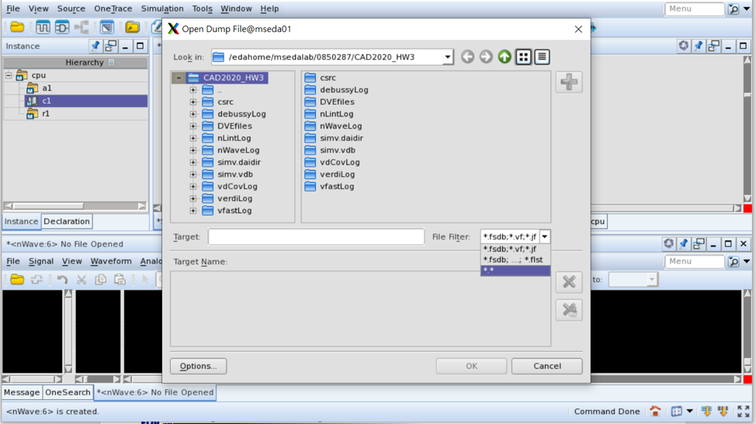

Slide 20
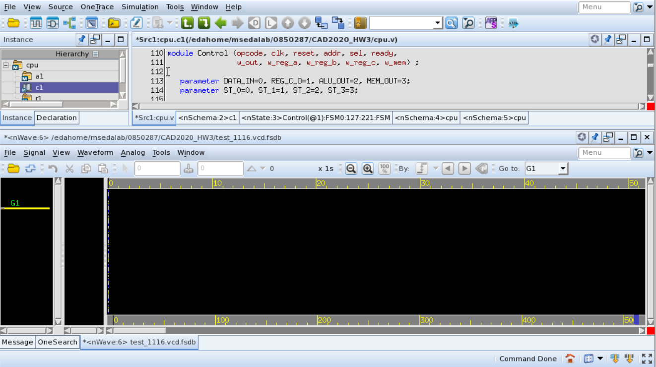
Get Signal

Slide 21
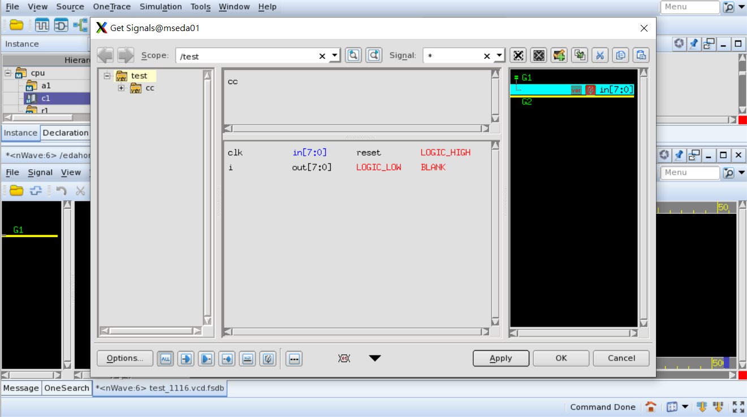

Slide 22
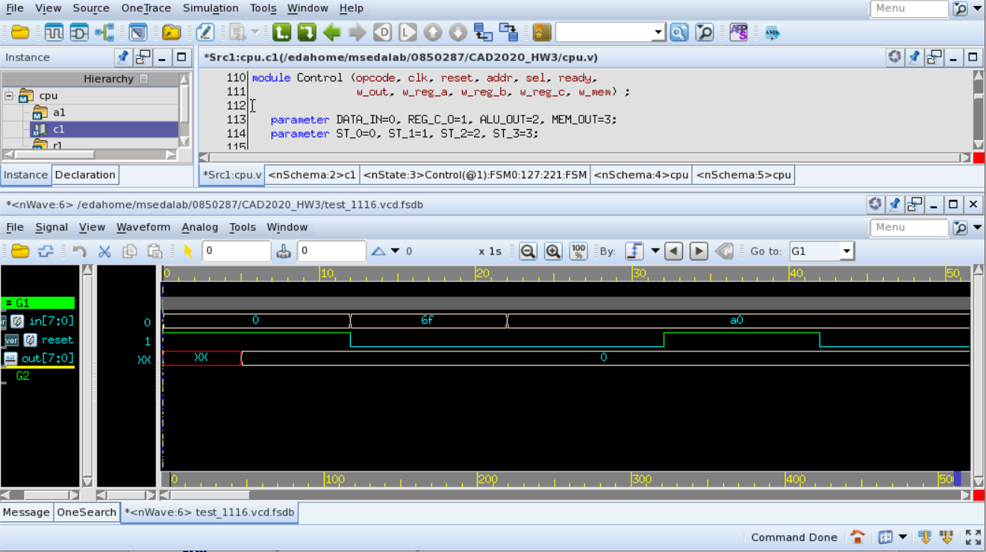

Slide 23
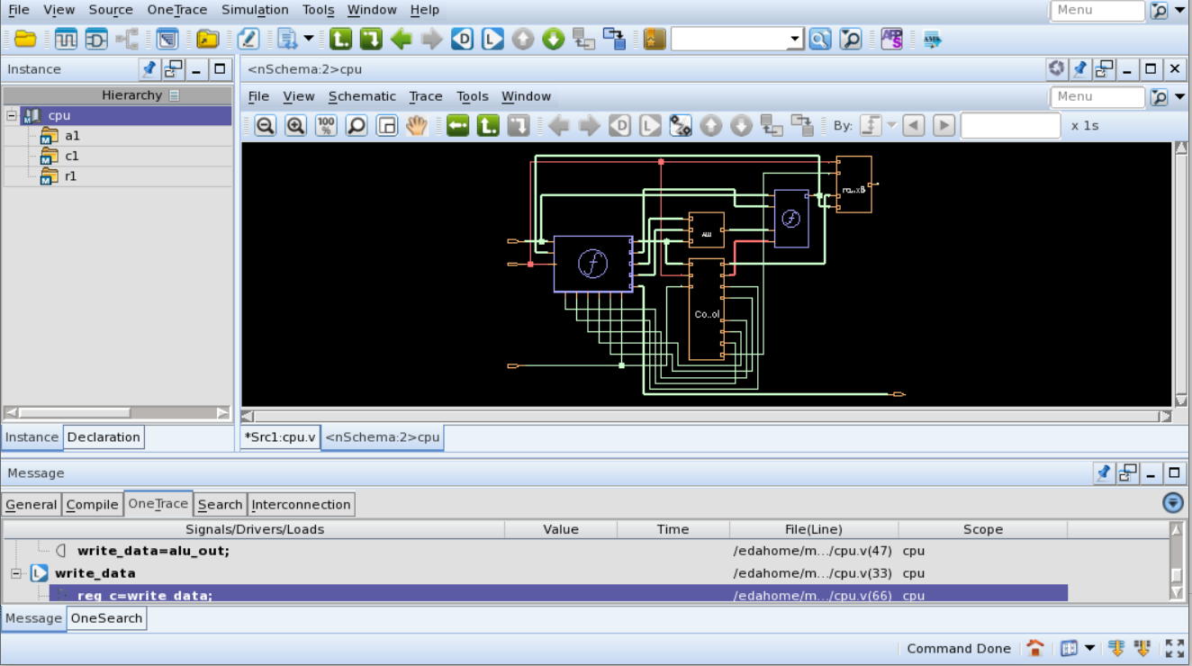
nSchema
New Schematic
(double click)

Slide 24
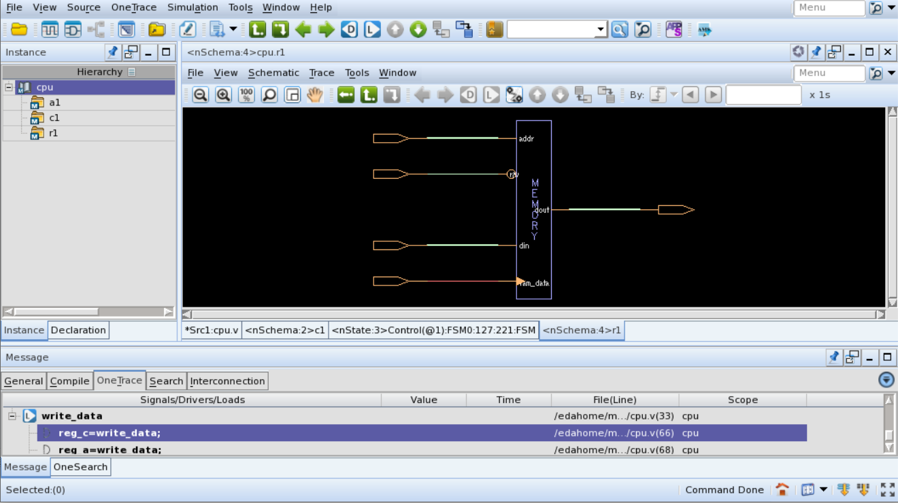
Pop View Up

Slide 25
(double click)

Slide 26
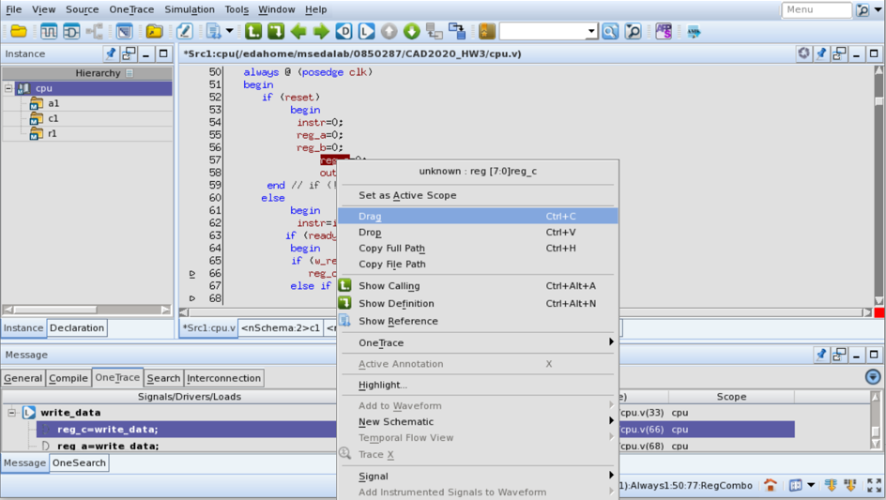
(right click)

Slide 27
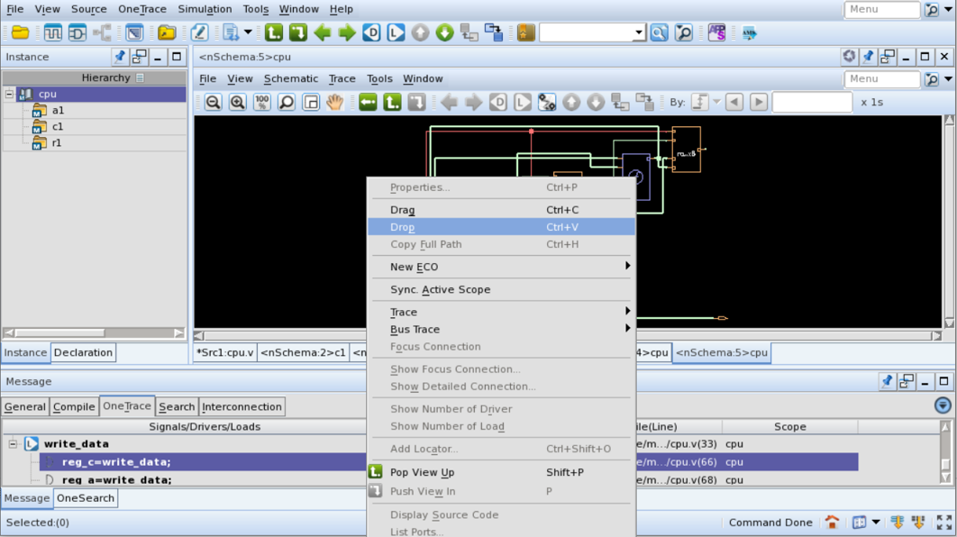

Slide 28
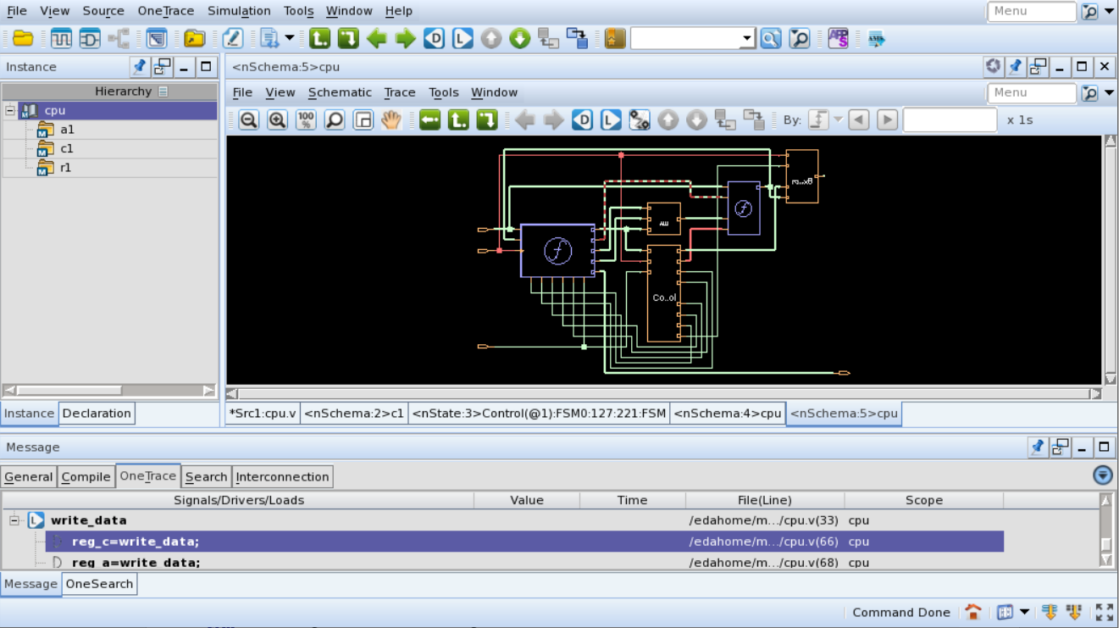
Dash line : Signal path

Slide 29
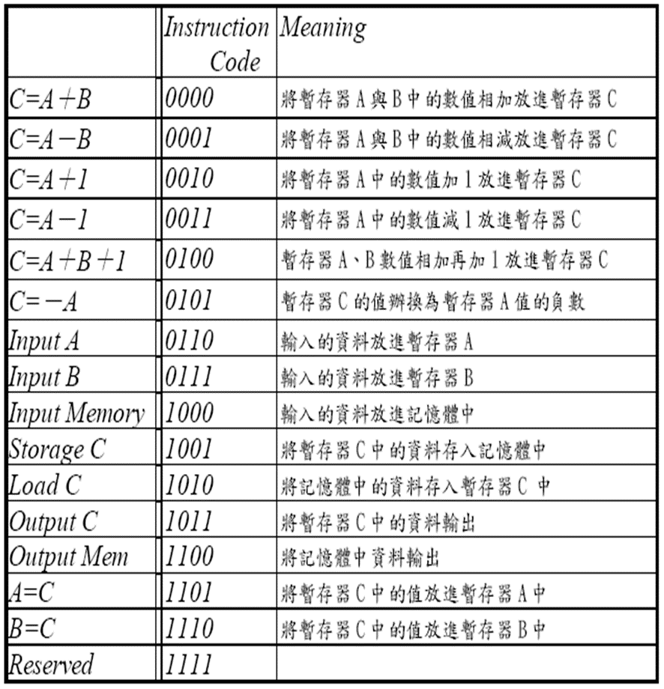
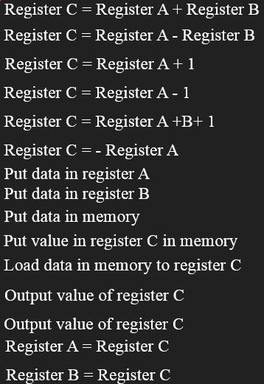
8-bit CPU Reference (1/2)

Slide 30
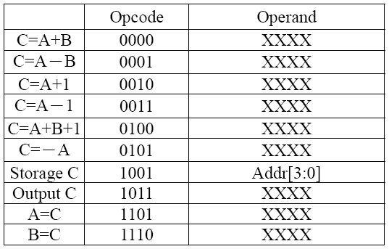
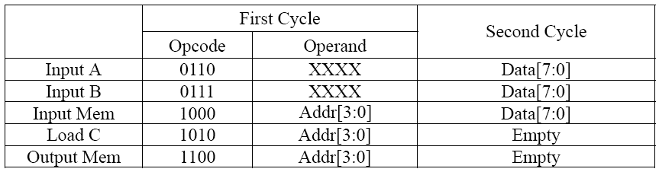
8-bit CPU Reference (2/2)
Single cycle instruction
Two cycle instruction

Slide 31
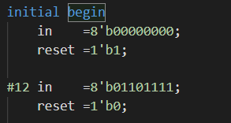
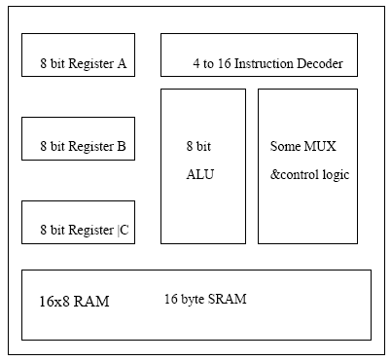
Test bench
Architecture
opcode
Delay time

Slide 32
Hand in
If you have any questions, please contact TA through new e3
Please upload a compressed file includes:
student-id_cpu.v
student-id_test.v
student-id_test_random.v
student-id_MiniReport.pdf
Please analyze:
Why coverage rate can’t reach 100% in problem 1(with coverage rate pictures)
Analyze problem 2 results (with coverage rate pictures)
Where is the bug in cpu_bug.v and how you correct it
What did you do to increase the coverage rate (with 100% coverage rate pictures)
What did you learn in this project
Upload to New e3
Deadline : 12/7 23:59

Slide 33
Some Tips
To do 1.
Need to give CPU an executable instruction
Two cycle instruction is seen as one pattern
Avoid to load the address without value or assign a value to that address
To do 2.
You don’t have to upload pattern to E3
No need to achieve 100% coverage
Just try to use less than 20 patterns to achieve the same or higher coverage compared to random patterns
To do 4.
You need to correct CPU_bug.v, and design an 100% coverage pattern for it
There is no restriction about the number of pattern

